Slide 1
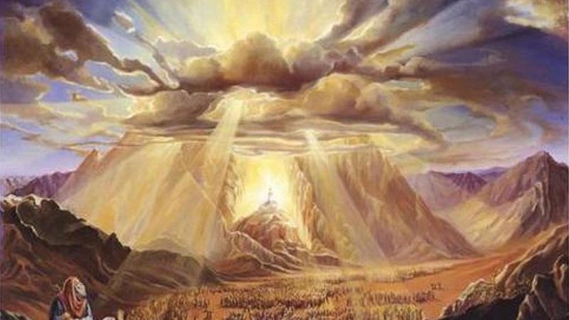
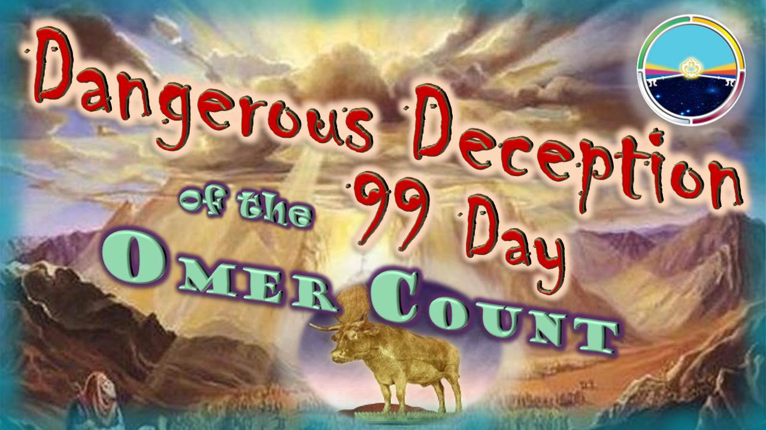

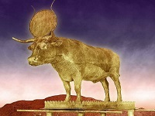
Dangerous Deception
99 Day
of the
Omer Count

Slide 2
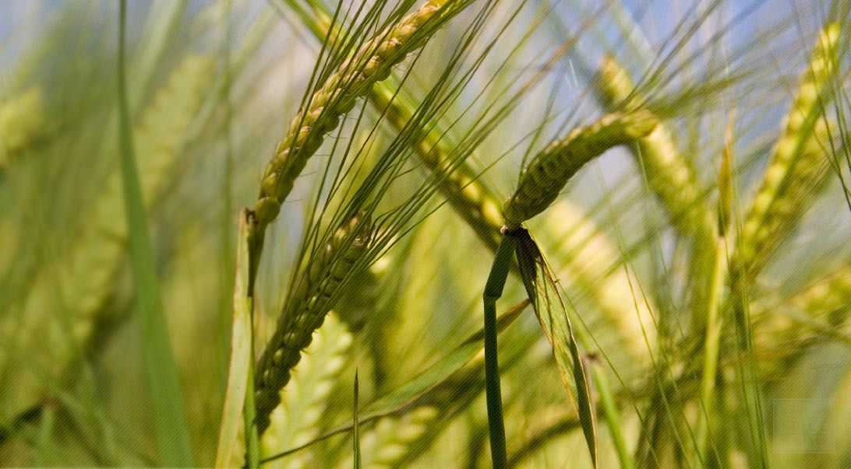

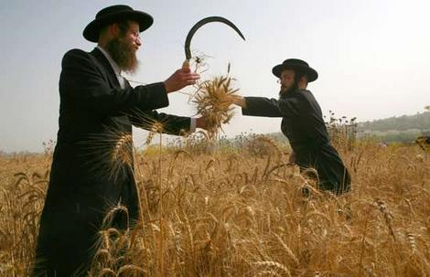
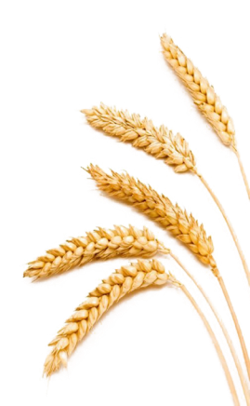
Why is the 99 day Omer Count so Dangerous?
Is Torah’s count that Confusing?
Can we trust any historical sources?

Slide 3

Omer Count Points to Ponder
It used to be that everyone knew the count to Shavuot
(or Pentecost) was 50 days from the waving of the
Firstfruits at Wave Sheaf. That is not the case anymore.
The conflict between the 50 or 99 day count to Shavuot is now
one of the largest controversies. In fact it is one of the most convoluted twists of a Torah count there ever could be.
There are many reasons why this has become so confusing –
with most of the confusion stemming from leadership – be
it from those of today, or historical scholars.
The average individual that wants to know the truth, usually
is not well-enough equipped to sort through the confusion
using Scripture alone.
Next option: Many turn to the internet, or secular historical sources for answers – not knowing if the information will
align with Torah or not. This is nothing short of dangerous!
But, all information gleaned just “sounds so good.”
Remember what Yahusha said four times in Matthew 24?
3

Slide 4
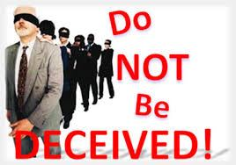


Know the Difference!
4

Slide 5
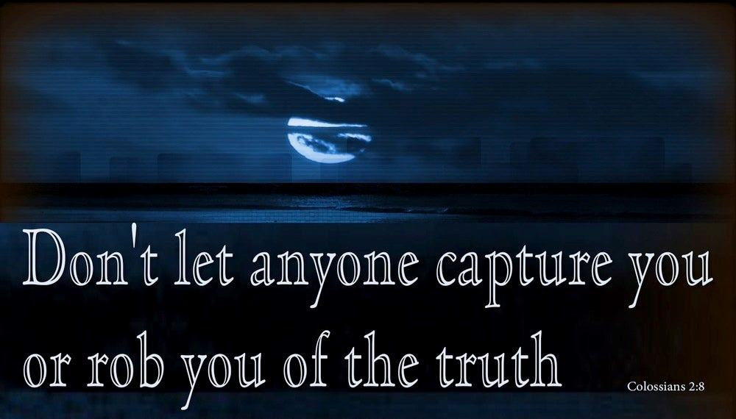


Deceived How?
… through philosophy and empty deceit, according to the tradition
of men …!
[TS2009]
5
…

Slide 6
Where is this deceit coming from?
Wikipedia
Jewish Feast Ministries
Lunar Sabbath Ministries
Historians
of Antiquity
…

Slide 7


Counting of the Omer: https://en.wikipedia.org/wiki/Counting_of_the_Omer
an important verbal counting of each of the
forty-nine days starting with the Wave Sheaf
offering of a sheaf of ripe barley and ending with
the First Fruits grain harvest, known as Shavuot.
Therefore the period of forty-nine days is between the Passover/Feast of Unleavened Bread, and Shavuot.
The Counting of the Omer begins
  (for Rabbinic Jews) on the second day of Passover (the 16th date of Nisan)
  (for Karaite Jews) day after the weekly
  Shabbat during Passover
  the 49 day count ends the day before
  the holiday of Shavuot, the 50th day.
Wikipedia
Barley instead of Wheat?
49/50 days instead of
99 days?
Which Jews are right? Rabbinic or Karaite?
Rabbinic Wave Sheaf DATE is Abib/Nisan 16.
Karaite Wave Sheaf DAY is always a 1st cycle.
Which day/date is right?
Shavuot is the 50th day,
not the 99th day.

Slide 8
Many Ministries with 50 Day Count
The New York Jewish Week says to count 50 Days from Abib 16. https://jewishweek.timesofisrael.com/omer-counting-in-the-digital-age/
Sefirat Ha Omer says to count 50 days from Abib 16. https://www.halachipedia.com/index.php?title=Sefirat_HaOmer
My Jewish Learning says to count 50 days from Abib 16. https://www.myjewishlearning.com/article/how-to-count-the-omer/
FIRM – Fellowship of Israel Related Ministries says to count 50 days from Abib 16. https://firmisrael.org/learn/counting-down-what-is-counting-the-omer/
Jewish Theological Seminary says: According to the Talmud, the Rabbinic interpretation has prevailed to count 50 days from Abib 16: https://www.jtsa.edu/counting-the-moments
Rood Awakening says to count 50 days from the 1st cycle
after weekly Shabbat. https://aroodawakening.tv/feasts-studies/feast/upcoming-feast-dates/
But there are many, who use the 99 day Omer
Count ~ especially lunar Sabbath calendars!
8

Slide 9





No wonder Jeremiah [16:19] said:
“Surely our fathers have inherited lies!”
“Woe to you learned in
the Torah, because you took away
the key of knowledge.”
Luke 11:52
[TS2009]
“Come & See!”
No wonder Yahusha said:

Slide 10
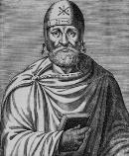
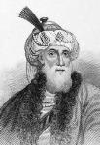
Both Philo & Josephus agree the Omer Count begins on Abib 16.
But, do they agree on the length of the Omer count as only 50 days?
What About ‘Trusted’ Jewish Historians for the “start” & “length” of the Omer Count?
The rabbis, their predecessors the Pharisees, and other Second Temple period authors such as Philo and Josephus, all understand “after Shabbat” as “after
the first festival (yom tov) of Matzot.” According to this interpretation, the counting
of the omer begins on the second day of Matzot [Abib 16].
For example, Philo writes (Special Laws 1:162):
But within the feast [of Matzot] there is another feast following
directly after the first day. This is called “The [wave] Sheaf.”^{[12]}
Josephus also follows this interpretation (Ant. 3:5 [250]):
On the second day of Unleavened Bread, that is to say the sixteenth, our people partake of the crops which they have reaped and which have not been touched
till then, and esteeming it right first to do homage to God to whom they owe the abundance of these gifts, they offer to Him the first-fruits of the barley…^{[13]}
https://www.thetorah.com/article/when-does-counting-the-omer-begin
^{Footnote references … [12]}
Philo, “On the Special Laws 1-4,” trans. Naomi G. Cohen, in Outside the Bible: Ancient Jewish Writings Related to Scripture (eds., Louis H. Feldman, James H. Kugel, and Lawrence H. Schiffman; Philadelphia: JPS, 2013), 1075.
…^{[13]} Josephus, Jewish Antiquities Books I-IV (trans., H. St. J. Thackeray; Loeb Classical Library; London: William Heinemann, 1967 [1930]), 438-441

Slide 11

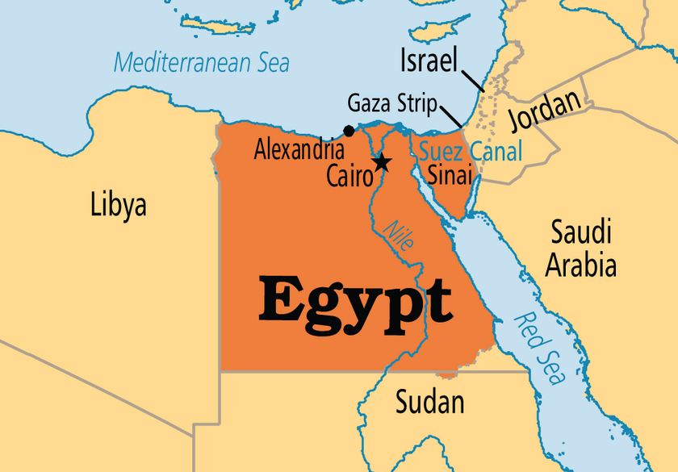
Who Was Philo?
https://en.wikipedia.org/wiki/Philo
Philo of Alexandria (20 BCE – 50 CE) was a Hellenistic Jewish philosopher who lived in Alexandria. His historical account shows the Jews in Judah were already using Abib 16 as Wave Sheaf long before Rabbi Rashbi died in 180 CE where Omer 33 is already linked to Abib 16.
Philo came from a priestly family – his deployment was to harmonize Jewish scripture, mainly the Torah, along with Greek philosophy
(often misunderstood). His ancestors and family had social ties and connections to the priesthood in Judea [very corrupt at that time!], the
Hasmonean & Herodian dynasties, etc. Philo received a thorough education in the Hellenistic cultures of Alexandria, ancient Rome/Egypt, and particularly the traditions of Judaism including Jewish traditional literature and Greek philosophy.
Philo visited the second temple in Jerusalem at least ONCE in his lifetime. [Didn’t he go up to the yearly feasts as Torah commands?] Philo would have been a contemporary of Jesus and His apostles.
[Question: Did Philo ever see any of these gospel people?]
Does Philo have the credentials to confirm the correct Shavuot count?

Slide 12
Support for Philo @
www.lunarsabbath.info/id15.html
This “other” website
endorses more than
a 50 day count.
For us to better understand how they counted Pentecost, let
us go to the eyewitnesses that lived at the time of our Saviour,
to see how it was done. [Question: Was Philo an eye-witness
(from Alexandria?) of any word or deed of Yahusha]?
Philo the Jew, [believing or unbelieving Jew??] who lived at the time, shows that the 50th day count to Pentecost “begins”
on the morrow “AFTER” the seventh Sabbath complete …
[Note: Compare this to the many Jewish websites and ministries ‘count’ from either Abib 16, or the morrow after the Sabbath in the Passover week.]
… NOT 50 days from the wave sheaf, and therefore the 50th day after the WAVE SHEAF is NOT Pentecost. You are to number 50 days after the 7th Sabbath and then offer the new grain offering on the day of Pentecost. The 50th day is counted from the day “after” the seventh Sabbath complete, NOT from the wave sheaf.

Slide 13


Support for Philo [con’t]
www.lunarsabbath.info/id15.html
Repeat: Pentecost “begins” on the morrow “AFTER” the seventh Sabbath complete … [This means that only 7 Sabbaths are being counted, NOT 7 completed weeks.
This count is from a floating Abib 16 married to Wave Sheaf.]
… NOT 50 days from the wave sheaf, and therefore the 50th day after the WAVE SHEAF is NOT Pentecost. You are to number 50 days after the 7th Sabbath and then offer the new grain offering on the day of Pentecost.. The 50th day is counted from the day “after” the seventh Sabbath complete, NOT from the wave sheaf.
Repeat: Pentecost “begins” on the morrow “AFTER”
the seventh Sabbath complete …
[This means that only 7 Sabbaths are being counted from Abib 16, NOT a full 7 completed weeks. This count is from a floating Abib 16 married to Wave Sheaf.]
[Pentecost count does NOT begin] 50 days from the wave sheaf.] [And - Wave sheaf is definitely not part of the Omer Count.]
Therefore the 50th day after the WAVE SHEAF is NOT Pentecost. You are to number 50 days after the 7th Sabbath and then offer the new grain offering on the day
of Pentecost. The 50th day is counted from the day “after” the seventh Sabbath complete, NOT from the wave sheaf.
What will Philo say?
Next, the website quotes Philo’s documentation.

Slide 14

Philo The Special Laws 11 pg 584
"The “solemn assembly” on the occasion of the “festival”
of the sheaf having such great privileges, is the “prelude” to “another” festival of still “greater importance;” for "from
this day” the “fiftieth day” is reckoned, making up the sacred number of seven sevens, with the addition of a “unit” as a
seal to the whole; and this festival, being that of the first fruits
of the corn, has derived its name of Pentecost from the number
of “fifty.”
Lunar-Sabbath Website says: … the sheaf was a solemn assembly Festival and from this day/16 was a prelude to another Festival of greater importance, referring to the Morrow after the seventh Sabbath, because FROM IT, the Morrow after the 7th Sabbath, the 50th day was reckoned. THE 50TH DAY WAS NOT RECKONED FROM THE WAVE SHEAF, but from the Morrow after the seventh Sabbath.
The traditional feast that people are keeping is the one that Philo says is more important than the wave sheaf because the 50th day, which is the GREATEST FEAST, is reckoned from it, and Pentecost is the “GREATEST” feast. This is in harmony with Lev-23 where it says “even unto the morrow AFTER the seventh Sabbath shall you number fifty days and then bring a new meat offering.”
www.lunarsabbath.info/id15.html

Slide 15


Can you sort out this confusion?
Note: When the Abib 16 Wave Sheaf falls on the 1st cycle [Sun] there will be 7 full weeks of 49 days. Then, that is the stopping point to begin counting the 50 days to Philo’s Shavuot. It adds to a total Omer count of 99 days!
IF Abib 16 falls on Mon. – Sab., the full count to Philo’s Omer will be less than 99.
50 Day Omer count
92-99 Day Omer count
Abib 16 Wave Sheaf is “THE” Problem!

Slide 16
An Omer Count of 92-99 days?
From these TWO Great Feasts, which one is NOT supported by “the Torah”?
Out of the
TWO Great Feasts, on which one is “the Law” given?
Abib 16
Wave Sheaf?
92-99 day Omer Count?
50 Day Omer count
92-99 Day Omer count

Slide 17
Support for Philo [con’t]
www.lunarsabbath.info/id15.html
Quoting from Philo page 704, chapter eight, he goes on to say,
“they [Orthodox Jews] devoted their whole lives and themselves
to the knowledge in contemplation of the … affairs of nature in accordance with the most sacred admonitions and … “precepts
of the Prophet Moses.” After saying this Philo continues by saying:
“In the first place, these men “assemble” at the “end” of seven weeks [for what event?], venerating not only the simple week of seven days, but also its multiplied power, for they know it to be pure and always virgin; and “it” is “a “prelude” and a kind of “forefeast”
of the “greatest” feast, which is assigned to the number fifty.”
Note: According to Philo, there were 2 feasts before Pentecost,
(1) the wave sheaf and (2) the Morrow after the seventh
Sabbath and both were called preludes to the feast of Shavuot.
The website uses Philo as an authority so their Shavuot reaches to a summer wheat harvest.

Slide 18


Philo Knows the Count of Shavuot?
www.lunarsabbath.info/id15.html
Remember, Philo is considered an authority because:
He is a “Jewish” historian who has studied the Torah!
But his writings are recording Jewish tradition ~
and NOT the Torah Truth! Do you see the problem?
Why is this website using Philo to give a “stamp
of approval” to their reckoning of Shavuot count?
The answer is simple: When Abib 16 does not always land on the 1st cycle, it is impossible to get a count of
7 completed weeks – so FIRST they just count 7 Sabbath days, THEN they add the count of 50 days which also includes 7 completed weeks.
Just a simple adjustment to support Abib 16, and “voila – Scriptural alignment” - HEAVILY INFUSED WITH “SYNCRETISM”!

Slide 19

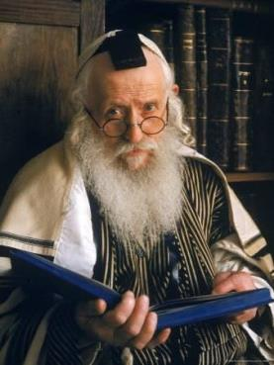
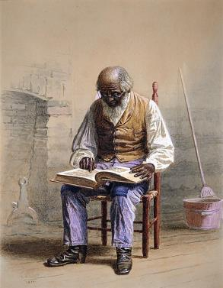
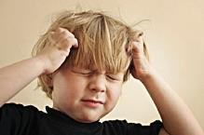

How should such a controversial & confusing study be conducted to find the truth of the Shavuot Count?
Do we put our trust in: 1) Rabbis & Jewish tradition; 2) Historical documents & philosophers;
OR 3) Old-fashioned Scripture study with
a foundation in Torah?
19

Slide 20
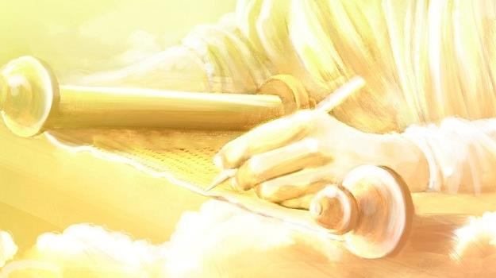


Covenant Calendar Studies Reveal Profound Secrets
Prov 25:2 It is the glory of Yahuah
to conceal a thing: but the honour of kings [Malki’s] is to search out a matter.
What is the secret to detecting a counterfeit?
Mark 4:22-23 For there is nothing hid, which shall not be manifested; neither was any thing kept secret, but that it should come abroad.
23 If any man have ears to hear, let him hear.
The truth must be found first!
Today’s study will reveal some interesting secrets for our ears to hear.
20

Slide 21
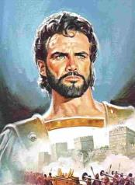
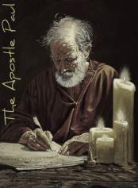
There is a striking difference between the 99 Day Omer Count of Counterfeit Calendars
in comparison to the count of Torah; Joshua 1st &
Paul in Acts 20-24!
Why is this the case?

Slide 22
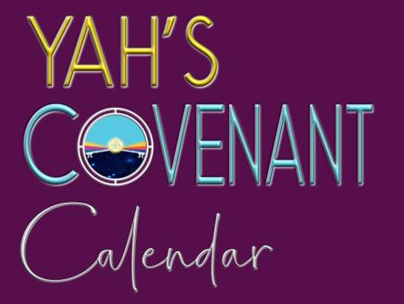
.
All of the answers to the dilemma of how to properly calculate the Shavuot count have already been provided!
The documentation is found in:
1) The Torah
2) Joshua
OT Witness
3) Luke/Paul NT Witness

Slide 23
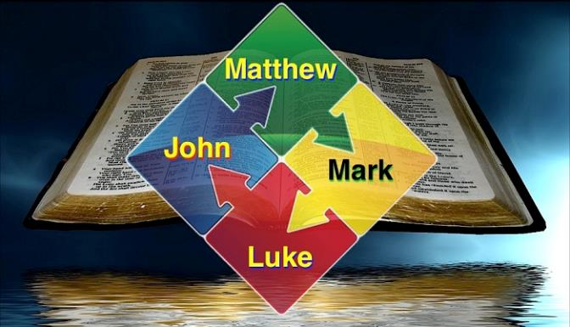

.
Let’s not forget the strongest witness for the Omer Count is in:
The Four Gospels
& Yahusha’s
Ministry!
This study also aligns with calendar clues in Noah’s Flood Account!

Slide 24
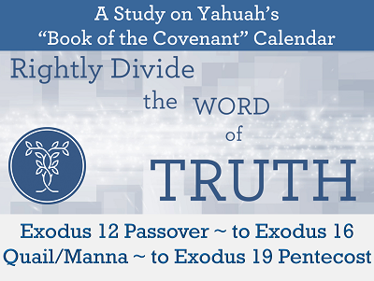

This study marks out with absolute clarity
1st month Passover; 2nd month Manna Week; 3rd month Shavuot with the completion of the 50 day Omer Count at Mt Sinai.
Exo 12 Passover to Exo 20 Pentecost [Jan 2018]:
https://studythecalendar.com/intro-exodus-12-passover-to-exodus-20-pentecost/

Slide 25

This study
marks out with absolute clarity that
Wave Sheaf follows
the day after the weekly Shabbat within the
Passover Festival.
Joshua & Wave Sheaf
3 Part Series [Apr 2021]: https://studythecalendar.com/joshua-wave-sheaf/

Slide 26
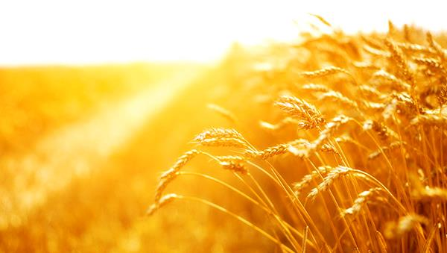
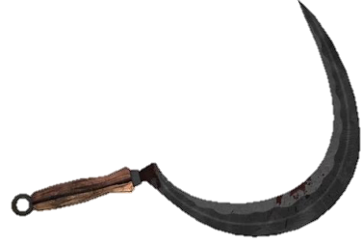
Many festal calendars promote barley sheaves for Wave Sheaf and Shavuot, yet other calendars want Shavuot to reach into mid-summer [July-Aug]
to the summer wheat harvest.
Torah shows Barley was only used in judgment
of an adulterous woman!

Slide 27
The Torah sickle will harvest
Wheat for the Wave Sheaf!
Only Wheat in the green ear will be waved for Wave Sheaf!
Only golden Wheat can be ground to fine flour for the
altar and the loaves at Pentecost/Shavuot!

Slide 28
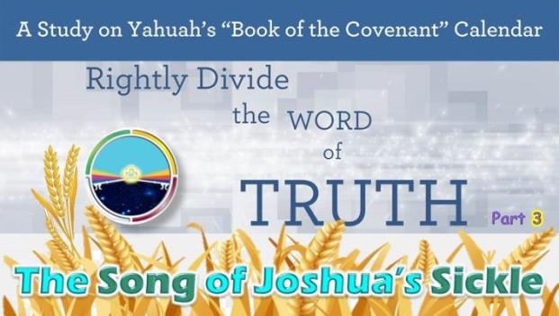
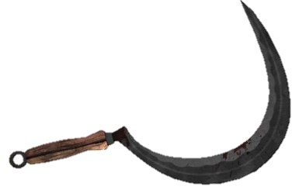
The Torah, and this Part 3 study
of Joshua’s sickle, mark out with absolute clarity that “only wheat” is used for the Wave Sheaf Offering,
NOT “barley!”
The Song of Joshua’s Sickle
Part 3 [Jan 2019]: https://studythecalendar.com/song-of-joshuas-sickle-pt-3-2/

Slide 29
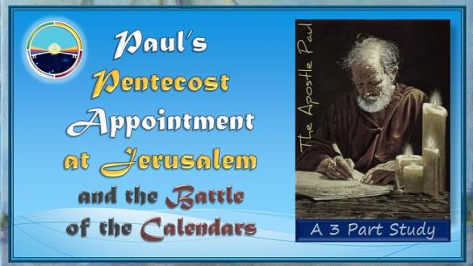
This study marks out with absolute clarity where Wave Sheaf begins as Omer
Count #1 & the journey to Jerusalem for Shavuot was completed before the 50 day Omer Count.
(Date: 30+ years after crucifixion!)
Paul’s Pentecost Appointment
3 Part Series [Jan 2021]:
https://studythecalendar.com/pauls-pentecost-appointment/

Slide 30
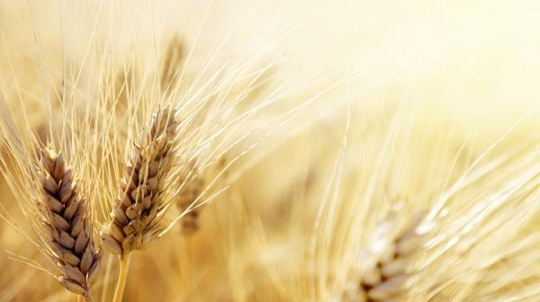
Things to remember for this study:
The Wave Sheaf offering during the Passover Festival was
wheat as it was in the greening of the ear [not barley].
This would have been the winter wheat.
By Shavuot (50 days after Wave Sheaf) this
winter wheat will ripen to golden grain, ready to provide
fine flour for the Pentecost loaves of bread.
Wheat was also planted at the equinox, of the new year.
This wheat will need about 100 days to become golden grain, ripening in July-Aug, being known as summer wheat. This summer wheat was used as seed for the next winter wheat crop.

Slide 31
Mosheh & the Exodus- Covenant Calendar Club
Note: There are many details in this study that are necessary to fully understand today’s study.
The first Passover out of Egypt proves:
Abib 1 – New Year Day: 4th cycle [Wed].
Abib 14 Passover: 3rd cycle [Tues].
Red Sea Crossing: Abib 17th night [Fri - 6th cycle].
If the Wave Sheaf Festival Pattern would
have been celebrated, placement would have
been Abib 19th [Sun] – start of Omer count.
Quail & 1st Manna week: 2nd Month from
17th – 23rd [1st – 7th cycles / Sunday - Sabbath].
Pentecost at Mt Sinai: 3rd Month 8th day [Sun].
<www.studythecalendar.com>

Slide 32
After a short review of Mosheh & the Exodus
today’s study will address:
The Double Pentecost Count (True or Counterfeit?)
An “added” English letter and the lingering effects.
Seven reasons NOT to accept a Counterfeit Omer count no matter where it comes from,
if accepted outside of Torah & Scripture witnesses.
Note: There will be many calendar slides for comparison!

Slide 33

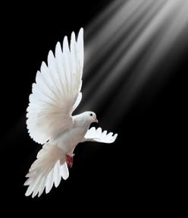
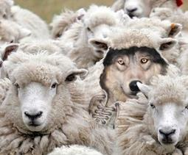
Knowing the End From the Beginning
Isa 46:9-10 Remember the former things of old: for I am Elohim, and there is none else; I am Yahuah, and there is
none like me, 10 Declaring the end from the beginning, and
from ancient times the things that are not yet done, saying,
My counsel shall stand, and I will do all my pleasure.
Will we find a wolf pretending to be a sheep?
All of the Covenant Calendar Studies mentioned solidly expose the correct Torah Omer Count.
This study will now compare
the evidence with Moshehs’
Omer Count to that of a
popular Omer Count of 99 days.
PAUL’S witness in the New Testament is in complete agreement with Mosheh’s testimony (Exo 12-26-20) and the Torah instructions.
Will the 99th day of the count be truth or error? OR…
33

Slide 34
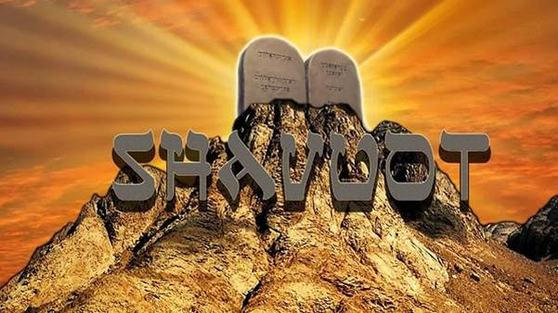
Reviewing the
Omer Count
from Egypt to Mt Sinai:
Exodus 12 - 16 - 20

Slide 35
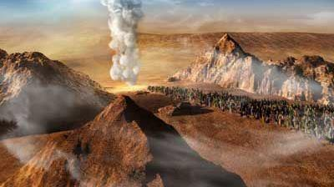
Three days’ journey into the wilderness ~
A command recorded three times in:
Exo 3:18; 5:3 & 8:27.

Slide 36

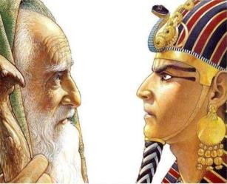
#1) Exo 3:18 The Elohim of the Hebrews hath met with us: and now let us go, we beseech thee, three days' journey into
the wilderness, that we may sacrifice to Yahuah our Elohim.
#2) Exo 5:3 The Elohim of the Hebrews hath met with us: let us go, we pray thee, three days' journey into the desert,
and sacrifice unto Yahuah our Elohim; lest he fall upon us
with pestilence, or with the sword.

Slide 37
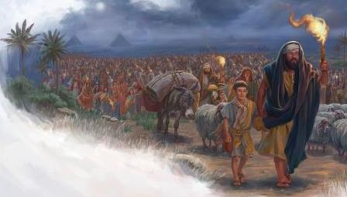
#3) Exo 8:27 We will go three days' journey into the wilderness, and sacrifice to Yahuah our Elohim, as He shall command us.
Yah’s Omer count begins in the wilderness!
As Yah does not change, neither does His Pattern of the Set-Apart Appointment – or Omer Count - to Shavuot.

Slide 38

Pentecost Torah Count of Yahuah
Lev 23:10-11, 15-16
10 When ye be come into the land which I give unto you, and shall reap the harvest thereof, then ye shall bring a sheaf of the firstfruits of your harvest unto the priest:
11 And he shall wave the sheaf before Yahuah, to be accepted for you: on the morrow after the sabbath [H7676] the priest shall wave it. (Note: Yahuah was keeping track of the count enroute to Mt Sinai.)
And ye shall count unto you from the morrow after the sabbath, from the day that ye brought the sheaf of the wave offering; seven sabbaths shall be complete: (7 completed weeks with
7 Sabbaths = 49 days.)
Even unto the morrow after the seventh Sabbath shall ye number fifty days; (The count after Wave Sheaf MUST reach to 50, which is the morrow after the 7th Sabbath.)
“Up to this point”
38

Slide 39


1st Month (Passover in Egypt)
1st [Sun] | 2nd [Mon] | 3rd [Tues] | 4th [Wed] | 5th [Thur] | 6th [Prep] | Sabbath
 |  |  | 1 New Year Day | 2 | 3 | 4
5 | 6 | 7 | 8 | 9 | 10 Lamb Chosen | 11
12 | 13 | 14 Passover | 15 [ULB #1] 1ST Day Journey | 16 [ULB #2] 2nd Day Journey | 17 [ULB #3] 3rd Day Journey | 18 [ULB #4] Day of Praise!
19 [ULB #5] WAVE SHEAF Omer #1 | 20 [ULB #6] #2 | 21 [ULB #7] #3 | 22 #4 | 23 #5 | 24 #6 | 25 #7
26 #8 | 27 #9 | 28 #10 | 29 #11 | 30 #12 | 1 | 2
Only IF Yahuah does not change!
Red Sea Night
Qodesh Omer Count PATTERN begins here!
1
Num 33:3 And they departed from Rameses in the first month, on the
fifteenth day of the first month; on the morrow after the passover …
There are 15 days of journey to the 30th day of the 1st month.

Slide 40
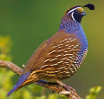
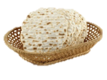
Please note which Cycle of the Week this was!
2nd Month (Quail & Manna)
1st [Sun] | 2nd [Mon] | 3rd [Tues] | 4th [Wed] | 5th [Thur] | 6th [Prep] | Sabbath
26 #8 | 27 #9 | 28 #10 | 29 #11 | 30 #12 | 1 #13 | 2 #14
3 #15 | 4 #16 | 5 #17 | 6 #18 | 7 #19 | 8 #20 | 9 #21
10 #22 | 11 #23 | 12 #24 | 13 #25 | 14 #26 | 15 Sin Wilderness #27 | 16 Murmuring #28
17 1st Manna Day #29 | 18 2nd Manna Day #30 | 19 3rd Manna Day #31 | 20 4th Manna Day #32 | 21 5th Manna Day #33 | 22 6th Manna Day #34 | 23 No Manna #35
24 #36 | 25 #37 | 26 #38 | 27 #39 | 28 #40 | 29 #41 | 30 #42
2
3
Exo 16:2
4
5
6
Exo 16:1 And they took their journey from Elim, and all the congregation of the children
of Israel came unto [travelled into] the wilderness of Sin, which is between Elim and Sinai,
on the fifteenth day of the second month after their departing out of the land of Egypt.

Slide 41

Moving to the 3rd Month - in CONTEXT!
Exo 19:1 In the third month -
after the children of Israel had come out of the land of Egypt …
on this [same] DAY [yowm] - [Not “DATE”]
REV
I
EW
The same 24 Hr. cycle of the week as the actual EXIT from Mitsrayim.
- The EXIT occurred on a 4th cycle of the week!
they came to the Wilderness of Sinai.
Now let’s APPLY this to some charts and see how it fits Scripture!

Slide 42
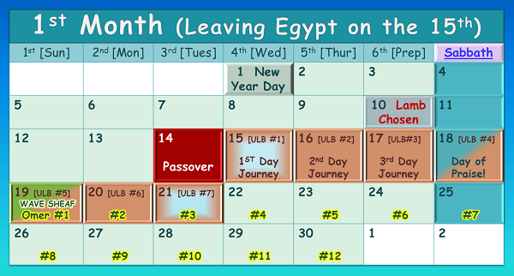

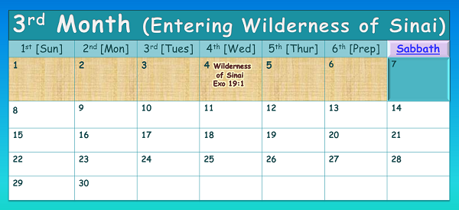


Which set of calendars demonstrate the SAME DAY?
#1
#2
The Exit!
#1 or #2 ??
The Same DAY!
Same DATE, different day!
REVIEW
42

Slide 43

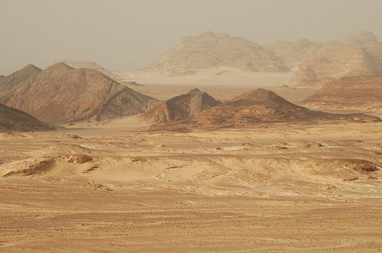
#1
REV
I
EW
This is the ONLY combination that will satisfy EVERY requirement of this calendar puzzle.
Israel entered the wilderness of Sinai on the same 4th cycle of the week as they left Egypt.
(It was not the same “date” of the month; specifically the 15th!)
The Exit!
The Same DAY!
43

Slide 44
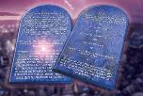
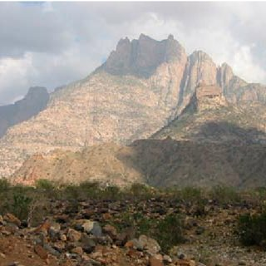


Exo 19:2 For they were departed from Rephidim, and come to the desert of Sinai, and had pitched in the wilderness; and there Israel camped before the mount.
Exo 19:1 In the third month after the children of Israel had come out of the land of Egypt, on this [same] DAY [NOT “DATE”] they came to the Wilderness of Sinai.
Note: Left Egypt on a 4th cycle; entered Wilderness of Sinai on a 4th cycle.
3rd Month (Pentecost at Mt Sinai)
1st [Sun] | 2nd [Mon] | 3rd [Tues] | 4th [Wed] | 5th [Thur] | 6th [Prep] | Sabbath
1 #43 | 2 #44 | 3 #45 | 4 Wilderness of Sinai Exo 19:1 #46 | 5 Trip #2 Mt Sinai Exo 19:2 #47 | 6 Trip #3 “today” Exo 19:10-11 #48 | 7 “tomorrow” #49
8 “3rd Day” & 50th Day! [Shavuot] | 9 | 10 | 11 | 12 | 13 | 14
15 | 16 | 17 | 18 | 19 | 20 | 21
22 | 23 | 24 | 25 | 26 | 27 | 28
29 | 30
Entering the Wilderness of Sinai &
Camping at the foot of Mt Sinai –
are 2 separate events on 2 different days!
Note the past tense
in vs. 2.
On the 5th cycle of the month, they camped before Mt Sinai.
Moses makes a trip up the mount; then delivers Yah’s message to the people.
Exo 19:3-6

Slide 45
Question: How can this 8th day be proven to be Yahuah’s Pentecost?
Answer: It links back to Torah’s Wave Sheaf according to Yahuah’s Omer Count.
Exo 19:1 In the third month after the children of Israel had come out of the land of Egypt, on this [same] DAY [NOT “DATE”] they came to the Wilderness of Sinai.
Note: Left Egypt on a 4th cycle; entered Wilderness of Sinai on a 4th cycle.
3rd Month (Pentecost at Mt Sinai)
1st [Sun] | 2nd [Mon] | 3rd [Tues] | 4th [Wed] | 5th [Thur] | 6th [Prep] | Sabbath
1 #43 | 2 #44 | 3 #45 | 4 Wilderness of Sinai Exo 19:1 #46 | 5 Trip #2 Mt Sinai Exo 19:2 #47 | 6 Trip #3 “today” Exo 19:10-11 #48 | 7 “tomorrow” #49
8 “3rd Day” & 50th Day! [Shavuot] | 9 | 10 | 11 | 12 | 13 | 14
15 | 16 | 17 | 18 | 19 | 20 | 21
22 | 23 | 24 | 25 | 26 | 27 | 28
29 | 30
7th Wk
1
2
50th Day
Exo 19:10-11 And Yahuah said to Mosheh, “Go to the people and set them apart today [6th day] and tomorrow [7th day].
And they shall wash their garments, [11] and shall be prepared by the third day.
3
For on the third day [8th day], Yahuah shall come down upon Mount Sinai before the eyes of all the people.

Slide 46
The 8th day of the 3rd month fulfills
the statute command for Shavuot!
In Covenant Calendar, some feast days are:
Locked to a “day/cycle”
Locked to a “date of a month”
Example #1: Wave Sheaf, Shavuot & the weekly Sabbath are fixed to a “cycle” but not to a “date.”
Example #2: Other festival commands are
fixed to a “date” but not to a “cycle.”
Covenant Calendar is not “locked”
together with “days” and “dates”
for weekly Sabbaths and feasts/festivals.
Example #1: Wave Sheaf, Shavuot & the weekly Sabbath are fixed to a “cycle” but not to a “date.”
Example #2: Other festival commands are
fixed to a “date” but not to a “cycle.”

Slide 47
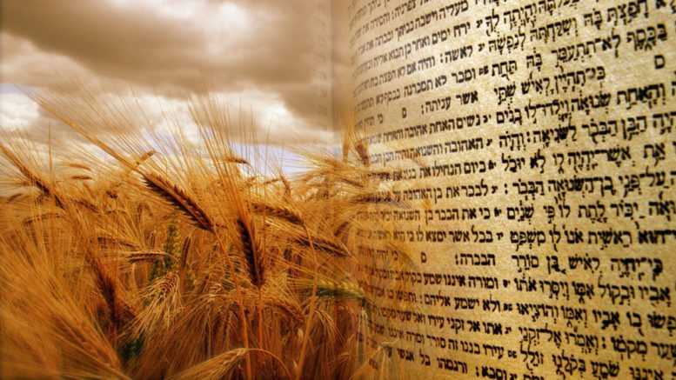


Next up: A comparison to an alternate Omer Count recognized as correct by some feast calendars
looking for a wheat harvest.
Are you ready
to go on a …
to examine the
99 day Pentecost count and the attached event?

Slide 48

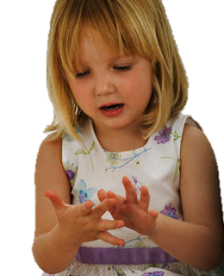



Shall we count to 50 or 99 for Pentecost?
Or anywhere between 92-99 days depending on the week day of Abib 16?

Slide 49

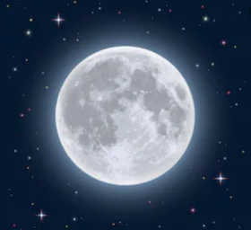
Campsite #11
Introduction
Mt Sinai is the 11th camping place out of
the 42 camp sites on the way to Canaan.
Israel was encompassed by pagan nations on every side – being held at bay by the divine protection of the Pillars of Cloud and Fire.
The root word for “Sinai” means
“tares, thorns and demons.”
In the Syriac language, “Sinai” means
“to shine as the moon,” which was an
object of worship in this area.

Slide 50
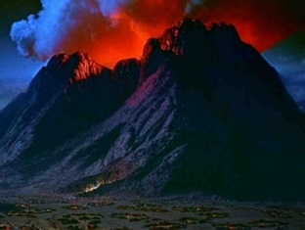
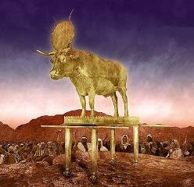
Campsite #11
In the New Testament these
root meanings link to “anti-christ.”
Yahuah chose this spot to proclaim Himself
as the highest Elohim with plans to bring
Israel into everlasting Covenant with Him –
to which they agreed, (for a very short time).
It was at this spot where His Pentecost Fire rained down upon Mt Sinai on the 50th day.
And it was at this spot where - 49 days later, Aharon erected the Golden Calf idol on an
altar (that still stands today) giving credit to the false trinity gods – most definitely including moon goddess worship!
Also in these very same verses of Exodus is where multiple COUNTERFEITS
are taught as the
TRUE Shavuot timing.

Slide 51
Alternate Pentecost Count In Torah?
Lev 23:10-11, 15-16
10 When ye be come into the land which I give unto you, and shall reap the harvest thereof, then ye shall bring a sheaf of the firstfruits of your harvest unto the priest:
11 And he shall wave the sheaf before Yahuah, to be accepted for you: on the morrow after the sabbath the priest shall wave it.
And ye shall count unto you from the morrow after the sabbath, from the day that ye brought the sheaf of the wave offering; seven sabbaths shall be complete: (Would that be 7 x 7 = 49 days for the “first part” of the count?)
Even unto the morrow after the
seventh Sabbath [The 49th day?] shall ye number fifty days ; (Add another
50 days? eg: Would that be: 49 + 50 = 99 days to the Pentecost count??)
51

Slide 52


Some say the Pentecost count
extends to 99 days ~ not 50 days!
COMPARE
1st Month (Passover in Egypt)
1st [Sun] | 2nd [Mon] | 3rd [Tues] | 4th [Wed] | 5th [Thur] | 6th [Prep] | Sabbath
 |  |  | 1 New Year Day | 2 | 3 | 4
5 | 6 | 7 | 8 | 9 | 10 Lamb Chosen | 11
12 | 13 | 14 Passover | 15 [ULB #1] 1ST Day Journey | 16 [ULB #2] 2nd Day Journey | 17 [ULB #3] 3rd Day Journey | 18 [ULB #4] Day of Praise!
19 [ULB #5] WAVE SHEAF Omer #1 | 20 [ULB #6] #2 | 21 [ULB #7] #3 | 22 #4 | 23 #5 | 24 #6 | 25 #7
26 #8 | 27 #9 | 28 #10 | 29 #11 | 30 #12 | 1 | 2
Keep in mind:
some counterfeit Wave Sheaf Omer Counts begin on
Abib 16.
1
Where will this “99” teaching lead to?

Slide 53
COMPARE
First we will count the 7 completed weeks including 7 weekly Sabbaths.
2nd Month (Quail & Manna)
1st [Sun] | 2nd [Mon] | 3rd [Tues] | 4th [Wed] | 5th [Thur] | 6th [Prep] | Sabbath
26 #8 | 27 #9 | 28 #10 | 29 #11 | 30 #12 | 1 #13 | 2 #14
3 #15 | 4 #16 | 5 #17 | 6 #18 | 7 #19 | 8 #20 | 9 #21
10 #22 | 11 #23 | 12 #24 | 13 #25 | 14 #26 | 15 Sin Wilderness #27 | 16 Murmuring #28
17 1st Manna Day #29 | 18 2nd Manna Day #30 | 19 3rd Manna Day #31 | 20 4th Manna Day #32 | 21 5th Manna Day #33 | 22 6th Manna Day #34 | 23 No Manna #35
24 #36 | 25 #37 | 26 #38 | 27 #39 | 28 #40 | 29 #41 | 30 #42
2
3
4
5
6
53

Slide 54
The 7 completed weeks & 7 weekly Sabbaths are now counted & = 49 days.
COMPARE
3rd Month (Doing “what” at Mt Sinai?)
1st [Sun] | 2nd [Mon] | 3rd [Tues] | 4th [Wed] | 5th [Thur] | 6th [Prep] | Sabbath
1 #43 | 2 #44 | 3 #45 | 4 #46 | 5 Trip #2 #47 | 6 Trip #3 “today” #48 | 7 “tomorrow” #49
Did Mosheh still need to make these trips up the mountain?
7 Wks
49 Days
1
2
What happened to counting “the 3rd day” that follows “tomorrow”?
The 3RD Day??
56 Days
8 #50 | 9 #51 | 10 #52 | 11 #53 | 12 #54 | 13 #55 | 14 #56
15 #57 | 16 #58 | 17 #59 | 18 #60 | 19 #61 | 20 #62 | 21 #63
22 #64 | 23 #65 | 24 #66 | 25 #67 | 26 #68 | 27 #69 | 28 #70
29 #71 | 30 #72 (~June 18) | 1 | 2 | 3 | 4 | 5
63 Days
70 Days
72 Days

Slide 55
We are now at 72 days
and still counting to the 99th day!
COMPARE
4th Month (~June 19th to July 19th)
1st [Sun] | 2nd [Mon] | 3rd [Tues] | 4th [Wed] | 5th [Thur] | 6th [Prep] | Sabbath
29 #71 | 30 #72 (~June 18) | 1 #73 | 2 #74 | 3 #75 | 4 #76 | 5 #77
6 #78 | 7 #79 | 8 #80 | 9 #81 | 10 #82 | 11 #83 | 12 #84
13 #85 | 14 #86 | 15 #87 | 16 #88 | 17 #89 | 18 #90 | 19 #91
19 #92 | 20 #93 | 21 #94 | 22 #95 | 23 #96 | 24 #97 | 25 #98
26 #99 (~July 15) | 27 | 28 | 29 | 30 | 1 | 2
77 Days
84 Days
91 Days
98 Days
99th Day
The 99th day is the 26th day of the 4th month (~July 15th) claimed to be the wheat harvest!

Slide 56
COMPARE
4th Month Review (~June 19th to July 19th)
1st [Sun] | 2nd [Mon] | 3rd [Tues] | 4th [Wed] | 5th [Thur] | 6th [Prep] | Sabbath
29 #71 | 30 #72 (~June 18) | 1 #73 | 2 #74 | 3 #75 | 4 #76 | 5 #77
6 #78 | 7 #79 | 8 #80 | 9 #81 | 10 #82 | 11 #83 | 12 #84
13 #85 | 14 #86 | 15 #87 | 16 #88 | 17 #89 | 18 #90 | 19 #91
19 #92 | 20 #93 | 21 #94 | 22 #95 | 23 #96 | 24 #97 | 25 #98
26 #99 (~July 15) | 27 | 28 | 29 | 30 | 1 | 2
77 Days
84 Days
91 Days
98 Days
99th Day
On the surface, this 99 day count may not seem to be a problem. Next we will overlay the events of Mosheh from Exo 24 & Exo 32 to see what happens.

Slide 57
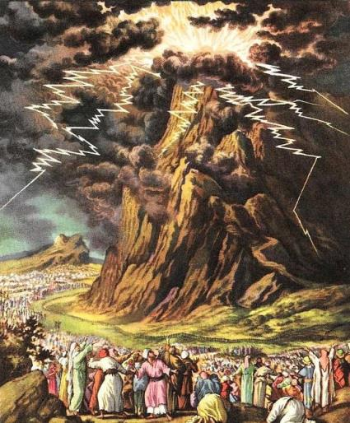
Review of Events in Exodus 19 – 20:20 (3rd Month)
19:6 Yahuah proposes His covenant to the people.
19:8 The people agree to come into covenant –
this is the 1st acceptance.
19:10 Sanctify themselves “today & tomorrow” [6th & 7th days of the 3rd month] … wash & be ready by the 3rd day!
19:11 On the 3rd day [8th day of 3rd month] the people
are to meet around the base of Mt Sinai – clean!
20:1-17 People meet [on the 8th day of 3rd month] to hear
the first 10 “Words” of Yahuah’s Covenant.
20:18-20 [8th day] People are frightened and beg
Mosheh to “go up the mount” to get the remaining “Words of the Covenant.”

Slide 58
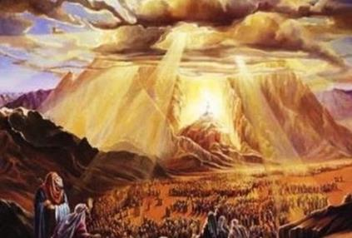
Review of Events in Exodus 20:21 – 24:11
20:21 - 23:33 [Still the 8th day – 1st cycle - Sunday]
  Mosheh “goes up the mount” [trip #5] to get the
  remaining “Words of the Covenant” for the people.
24:1-8 [Still the 8th day – 1st cycle - Sunday]
  Mosheh speaks the rest of the Words of the Covenant
  to the people – 2nd acceptance for Yahuah’s Covenant;
  Mosheh writes these laws in the Book of the Covenant;
  Moses reads the Covenant Words to the people;
  people give 3rd acceptance for Yahuah’s Covenant;
  the Book of the Covenant was then blood ratified;
  the people are sprinkled with blood.
24:9-11 [approx. 9th & 10th days – 2nd & 3rd cycle - Mon & Tue]
  a total of 75 elders journey part way up Mt Sinai
  to partake of the Covenant Confirming Meal.
(8th day; 3rd Month)
Shavuot [Pentecost]
50th Day from
Wave Sheaf
Appointment Pattern
Remember, this is the -
Let’s chart these events on the calendar months.

Slide 59



1st [Sun] | 2nd [Mon] | 3rd [Tues] | 4th [Wed] | 5th [Thur] | 6th [Prep] | Sabbath
1 #43 | 2 #44 | 3 #45 | 4 #46 1st day in the Wilderness of Sinai Exo 19:1 | 5 #47 Trip #2 Mt Sinai Exo 19:2 | 6 #48 Trip #3 “today” Exo 19:10 | 7 #49 “tomorrow” Exo 19:10
8 #50 Trips 4-5 “the 3rd Day” & Shavuot Exo 20:1 – 24:8 | #51 Trip 6a “75 elders meet in Mt Sinai” Exo 24:9-10 | #52 “75 elders eat covenant meal” Exo 24:11 | 11 #53 Trip 6b | 12 #54 | 13 #55 | 14 #56
15 #57 | 16 #58 | 17 #59 Trip 6c | 18 #60 | 19 #61 | 20 #62 | 21 #63
22 #64 | 23 #65 | 24 #66 | 25 #67 | 26 #68 | 27 #69 | 28 #70
29 #71 | 30 #72 (~June 18)
3rd Month (Detail of Events & Counting to 99)
50th Day
Mosheh gives instructions to Aharon. [Exo 24:14]
Together Mosheh & Joshua prepare to go further up Mt Sinai for the next 7 days. [Exo 24:12-16a]
Moses leaves Joshua on day 7 to ascend to the top. [Exo 24:16b-17]
Moses will be UP in Mt Sinai for the
next 40 days & 40 nights. Exo 24:18
4 Days
11 Days
13 Days
Mosheh was UP in the consuming fire of Mt Sinai for
the last 13 days of the 3rd month. [See Exo 24:17.]

Slide 60
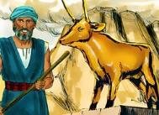
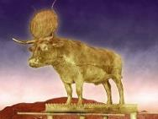
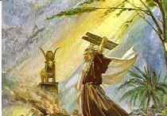
1st [Sun] | 2nd [Mon] | 3rd [Tues] | 4th [Wed] | 5th [Thur] | 6th [Prep] | Sabbath
29 #71 | 30 #72 (~June 18) | 1 #73 | 2 #74 | 3 #75 | 4 #76 | 5 #77
6 #78 | 7 #79 | 18 #80 | 9 #81 | 10 #82 | 11 #83 | 12 #84
13 #85 | 14 #86 | 15 #87 | 16 #88 | 17 #89 | 18 #90 | 19 #91
20 | 21 | 22 | 23 | 24 | 25 | 26
27 #99 (~July 15) | 28 | 29 | 30
4th Month Events (~June 19th to July 18th)
13 Days
18 Days
Mosheh will be staying UP in the consuming fire of Mt Sinai
for the first 27 days of the 4th month. [See Exo 24:17.]
25 Days
In the meantime, Aharon is fashioning a golden calf for worship. [See Exo 32:1-6.]
32 Days
#98
#92
#93
#94
#95
#96
#97
39 Days
#99
27th day [4th month]: Mosheh completes the 40th day [Exo 24:18].
Mosheh [with the tablets] meets Joshua to return to camp –
only to find [on the 99th day of the counterfeit Pentecost count]
the camp is worshipping a golden calf!
40th Day!
99th Day

Slide 61



1st [Sun] | 2nd [Mon] | 3rd [Tues] | 4th [Wed] | 5th [Thur] | 6th [Prep] | Sabbath
29 #71 | 30 #72 (~June 18) | 1 #73 | 2 #74 | 3 #75 | 4 #76 | 5 #77
6 #78 | 7 #79 | 18 #80 | 9 #81 | 10 #82 | 11 #83 | 12 #84
13 #85 | 14 #86 | 15 #87 | 16 #88 | 17 #89 | 18 #90 | 19 #91
20 #92 | 21 #93 | 22 #94 | 23 #95 | 24 #96 | 25 #97 | 26 #98
27 #99 (~July 15) | 28 | 29 | 30
4th Month Events in Question
Exo 32:4 “These be thy gods, O Israel, which brought thee up out of the
land of Egypt!”
Is it feasible for a 99 Day Omer Count to be genuine for the giving of the Stone Tablets?
18 Days
25 Days
Aaron’s
Calf
32 Days
99th Day
39 Days
Shall we note Mosheh’s brutal response?
This ‘golden calf’ actually represents the full worship of the false trinity!
Round Disc = Nimrod/Baal [sun god];
Altar = Semiramis/Ashtoreth [moon goddess]; Calf = Tammuz [false messiah]!
40th Day!

Slide 62
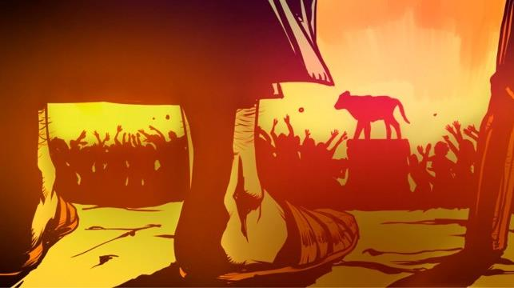


The children of Israel fell into idolatry by worshipping the pagan trinity, while professing to worship Yahuah.
Many are temped by this same false worship today.
When rebellious worship is offered to Yahuah the same way as the pagans worship their false gods, can Yahuah’s Ruach continue to dwell in
their “soul temple”?
Say “no”
to 99!

Slide 63

Reason #1 to say “no” to
the 99 day Omer count ~
~ it honors the
golden calf!

Slide 64

Is there another witness against this 99 day Omer Count that needs to be considered?

Slide 65


From the Words of the SEPTUAGINT
Lev 23:15-16
And ye shall number to yourselves from the day
after the Sabbath, from the day on which ye shall
offer the sheaf of the heave-offering, seven full weeks:
until the morrow after the last week ye shall number fifty days,
and shall bring a new meat-offering to Yahuah.

Slide 66

True Pentecost Count In Torah
Lev 23:10-11, 15-16
10 When ye be come into the land which I give unto you, and shall reap the harvest thereof, then ye shall bring a sheaf of the firstfruits of your harvest unto the priest:
11 And he shall wave the sheaf before Yahuah, to be accepted for you: on the morrow after the sabbath the priest shall wave it.
And ye shall count unto you from the morrow after the sabbath, from the day that ye brought the sheaf of the wave offering; seven sabbaths shall be complete: (Would that be 7 x 7 = 49 days for the first part of the count?)
Even unto the morrow after the seventh Sabbath [The 49th day?] shall ye number fifty days ; (Add another 50 days? eg: Would that be: 49 + 50 = 99 days to the Pentecost count??)
Let’s consider the Hebrew word for
UNTO, H5704 - “ad”
ע ד
66

Slide 67
~ UNTO ~
BLB
EDHL –
1. – to, unto, up to, even to,
2. – eternity, perpetuity
3. – booty, (to tear away)
4. – witness, testimony
5. – menstruation (the cloth)
preposition
as far as, even to, until, up to, while, as far as
  of space
    as far as, up to, even to
  in combination
    from...as far as, both...and (with 'min' - from)
  of time
    even to, until, unto, till, during, end
  of degree
    even to, to the degree of, even like
    conjunction
until, while, to the point that, so that even

Slide 68




~ UNTO ~
Gesenius’
Lexicon
Definitions must be chosen according to context!

Slide 69



Gesenius con’t
A limiting border is established at the referenced article!
Lev 23:15 SEVEN COMPLETED SABBATHS …

Slide 70



Gesenius con’t
AGAIN – AN ESTABLISHED REFERENCE
POINT with a RESTRICTION!
Lev 23:15 SEVEN COMPLETED SABBATHS …

Slide 71
What is the Divine Statute INSTRUCTION that we are to consider with this highly defined point of reference?
The SEVEN COMPLETED SABBATHS! [Lev 23:15].
Lev 23:16 UNTIL the MORROW AFTER …
(at the point of the subsequent 24 hour period following;
in other words – when your walk to Hawaii encounters the west coast of North America, your WALK stops!)
Not 14!
Lev 23:16 Until the morrow after the SEVENTH SABBATH …

Slide 72


Lev 23:16 … you count fifty day.
Hey Author! Don’t you know English requires an “S” here?
Oh Sure! But the original Hebrew does NOT indicate a plurality!
Lev 23:16 makes no mistake that this precise day after the 7th completed Shabbat is specifying ONLY ONE
HIGHLY PARTICULAR
24 HOUR CYCLE!
YOWM! - Not Yowmim (plural)

Slide 73


What if the translators considered the singular Hebrew grammar effect and …
On the morrow after the 7th completed Sabbath …
Lev 23:16 … you count fifty day.

Slide 74




Lev 23:16 … you count
DAY FIFTY!
On the morrow after the 7th completed Shabbat …
ONE SPECIFIC YOWM!
Shavuot ~ Yahuah’s Harvest
according to (Hebrew) Torah statute.

Slide 75

Reason #2 to say “no” to
the 99 day Omer count ~
~ it does not honor the
original Hebrew intent!

Slide 76
Another Witness From the Words of Acts
Acts 1:3-4
To whom also He shewed Himself alive after His passion by many infallible proofs, being seen of them forty days, and speaking of the things pertaining to the kingdom of Yahuah:
And … commanded them that they should not depart from Jerusalem, but wait for the promise of the Father.
Acts 2:1-4
And when the day of Pentecost was fully come, they were all with one accord in one place. And suddenly there came
a sound from heaven as of a rushing mighty wind, and it filled all the
house where they were sitting.
And there appeared unto them cloven tongues like as a fire, and it sat upon each of them. And they were all filled with the Ruach ha Qodesh …

Slide 77

What does this
witness from Acts prove?
Absolutely Nothing … at this time!

Slide 78


#3 Reason:
The answer is found in the study of
a ship’s
voyage as
given on
23 Jan 2021.
No 99 Day
Omer Count Here!
Paul & the Battle of the Calendars
Videos Parts 1, 2 & 3: https://studythecalendar.com/pauls-pentecost-appointment/

Slide 79

The 99 Day
Count
… is also being taught by many Lunar-Sabbath feast keepers.
Why? Because most feel barley is the Wave Sheaf grain, so they are seeking a summer wheat harvest for Shavuot without realizing the wheat [fine flour] for Wave Sheaf is from the former year’s winter seeding. As a result there is wheat for the 50 day Shavuot Omer Count ~ no problem!
Moon
Locked
Calendar!

Slide 80




.
Yahusha as a Kernel of Wheat
CONS
IDER
1st (Sun) | 2nd (Mon) | 3rd (Tues) | 4th (Wed) | 5th (Thur) | 6th (Fri) | 7th (Sabb)
4 | 5 | 6 | 7 | 8 | 9 | 10
11 | 12 | 13 | 14 P/O | 15 ULB | 16 ULB | 17 Ress.
18 W/S | 19 ULB | 20 ULB | 21 ULB | 22 | 23 | 24
John 12:23-24
And Yahusha answered them, saying, The hour is come,
that the Son of man should
be glorified. 24 Verily,
verily, I say unto you, Except a corn of wheat fall into the ground and die, it abideth alone: but if it die, it bringeth forth much fruit.
70 weeks of ministry ~ He’s the Wheat of the 49th year, and the Wave Sheaf of the 50th year!

Slide 81
The 99 Day
Count
… is also being taught by
many Jewish historians.
Why? Because they can only report what was happening in the corrupt priesthood of Jerusalem and Judea – as eye-witnesses [Josephus], or hearsay witnesses [Philo]. These witnesses are NOT a guarantee of
Torah Truth! They just report what they see happening. And what is
the great event that happened on the 99th day of the Omer Count??
Has anyone heard of “the” great event for celebration?

Slide 82


Reason #4 to say “no” to
the 99 day Omer count ~
~ it does not honor
the Old Paths of
the Prophets!

Slide 83


Reason #5 to say “no”
to the 99 day Omer count ~
~ it does not honor the Wave Sheaf, the Wheat Harvest - OR –
the words of Moses in Torah!
Wheat Harvest!

Slide 84



Reason #6 to say “no”
to the 99 day Omer count ~
The
It removes
Eh-Tzem
from the Wave Sheaf
~ by not honoring every Torah statute.
Mo-edim
Rev 18:4 Come out of her my people!

Slide 85

EVERY word and concept in Scripture has DEFINITE PURPOSE.
Why is it that the statute of 7 completed Shabbats seems to lack any type of reason or fulfillment pertaining to our Salvation ~
… when the additional Omer Count takes precedence [be it 92-99 days]?

Slide 86




Yahusha’s 40th day of the Omer count – the day He ascended to heaven
- was the 27th day of the 2nd month, the exact same date as
Noah leaving the ark.
There is nothing in the Gospels for us to take note of a 99th day for the Omer count, or another count past
Shavuot as the 50th Day!
Reason #7 to say “no” to the 99 day Omer count ~

Slide 87




Are You Amazed?
Are you amazed at how some of the most popular Jewish historians actually believed Wave Sheaf is dated to Abib 16 and that Shavuot could be from 92-99 days later?
Why would they believe such, except they
are following a corrupt Jewish system?
Do you think they were consulting Judaism and the Talmud, or is there another reason?
Would this have anything to do with
“taking away the key of knowledge
and understanding”? (Luke 11:52)
#1
Will you choose the Scripture witnesses or the Jewish historians who don’t have everything correct?
#2
#3
#4

Slide 88




What do you think? Has Torah shown you what great event happened on
the 99th day of an Omer Count?
Did Mosheh, the MelekTzedek, celebrate that 99th day event?
Or is the truth like this?! …
1) Rabbis & Jewish tradition;
2) Historical documents &
3) Historians or philosophers
~ are no match for Torah if they are following philosophies and Jewish/Talmud traditions.

Slide 89


Stay rooted in Torah; know how to study, understand and follow Torah; know how to align Torah with the footsteps of your Master in the Gospels. Know how to count and honor all of His worship statutes.
The End!

Slide 90


If you have Questions
&/or Comments
about this teaching,
please contact:
Timothy Astleford or
Charlene Fortsch
questions@studythecalendar.com
Thank you & Shalom!

